Slide 1
Flight options
[Your name and travel agency company name]
Notes:
Add your name and the made-up name of your travel agency company.
Add the name of your travel agency.
Resources are updated regularly - the latest version is available at: the-cc.io/curriculum.
This resource is licensed by the Raspberry Pi Foundation under a Creative Commons Attribution-NonCommercial-ShareAlike 4.0 International license. To view a copy of this license, visit, see creativecommons.org/licenses/by-nc-sa/4.0/.

Slide 2
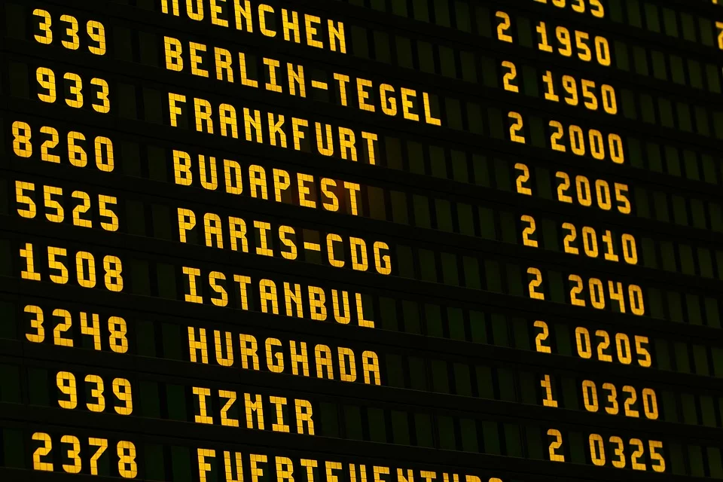
Task
Find a flight from London to Nairobi on 17 August, and a return flight on 30 August.
Name of flight search website used:
Notes:
Add the name of flight search website you have used here.
Image from https://pixabay.com/photos/airport-board-flying-scoreboard-1890943/

Slide 3
A direct flight
Price:
Airline:
Duration:
Advantages:
Disadvantages:
Notes:
Add the details of the first flight option from the flight search website.

Slide 4
A flight with two stops
Price:
Airline:
Duration:
Advantages:
Disadvantages:
Notes:
Add the details of the second flight option from the flight search website.

Slide 5
A flight arriving earliest in the morning
Price:
Airline:
Duration:
Advantages:
Disadvantages:
Notes:
Add the details of the third flight option from the flight search website.

Slide 6
Recommended flight: which do you recommend?
I recommend….
because….
Notes:
Add the details of your recommended flight, with reasons for choosing this option instead of the others. Add details of how you used the flight search website to arrive at this option, e.g. using filters or sorting options to narrow down your search.

